Slide 1
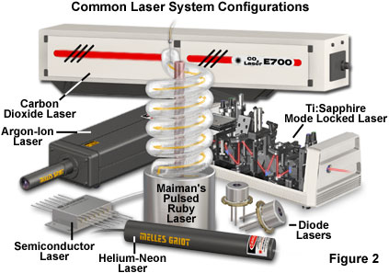

Slide 2
Light Amplification by Stimulated Emission of Radiation- (LASER).
A laser is a device that can produce a very narrow intense beam of monochromatic coherent light.
A laser is a device that generates light by a process called STIMULATED EMISSION.

Slide 3
Properties of Laser Light
Monochromaticity
Laser light is concentrated in a narrow range of wavelengths
Coherence
All the emitted photons bear a constant phase relationship with each other in both time and phase
Directionality
laser light is usually low in divergence
High Irradiance
light possesses high radiant power per unit area

Slide 4
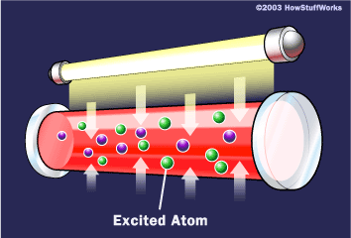
Absorption
E₁
E₂

Slide 5
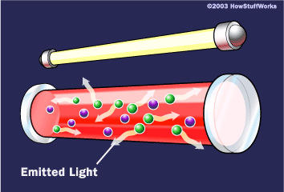
Spontaneous Emission

Slide 6
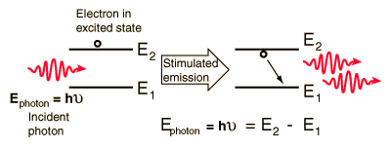
Stimulated Emission
The emitted photon is identical in all respects to the incident photon. Its frequency is same. It is in the same phase with the incident photon. Both photons travels in the same direction and are in the same state of polarization

Slide 7
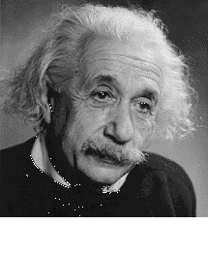
Atoms in an excited state can be stimulated to jump to a lower energy level when they are struck by a photon of incident light whose energy is the same as the energy-level difference involved in the jump. The electron thus emits a photon of the same wavelength as the incident photon. The incident and emitted photons travel away from the atom in phase.
This process is called stimulated emission.

Slide 9
Einstein’s coefficients
Einstein calculated the probability of
absorption, spontaneous emission
and stimulated emission
Probability of absorption
(P₁₂)_{ab} =ρ(ν) B₁₂
B₁₂ = Einstein’s coefficient for absorption
Probability of Spontaneous emission
(P₂₁)_{sp} =A₂₁
A₂₁ = Einstein’s coefficient for spontaneous emission
Probability of Stimulated emission
(P₂₁)_{st} = ρ(ν) B₂₁
B₂₁ = Einstein’s coefficient for stimulated emission
ρ(ν) = photon density
E₂
E₁

Slide 10
Number of absorption at any instant of time Δt is given as,
N_{ab} = N₁ρ(ν) B₁₂ Δt
( N₁- No of atoms at E₁)
Number of spontaneous emission at any instant of time Δt is given as,
(P₂₁)_{sp} = N₂ A₂₁ Δt
( N₂- No of atoms at E₂)
Number of stimulated emission at any instant of time Δt is given as,
(P₂₁)_{st} = N₂ ρ(ν) B₂₁ Δt

Slide 11
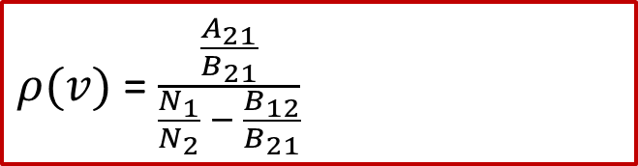
Relationship between the Einstein Coefficients
To establish the relationship between Einstein Coefficient few assumptions are made:
The atoms and the radiation are in thermal equilibrium.
The radiation is identical with black body radiation and consistent with Planck's radiation law for any value of T.
The population densities N₁ and N₂ at the lower and upper energy levels respectively are constant in time and are distributed according to Boltzmann law in the energy levels.
Under thermal equilibrium,
Number of upward transition = Number of downward transition
N_{ab} = N_{sp} + N_{st}
N₁ ρ(ν) B₁₂ Δt = N₂ ρ(ν) A₂₁ Δt + N₂ ρ(ν) B₂₁ Δt
ρ(ν)[B₁₂ . N₁ - B₂₁. N₂] = A₂₁ .N₂
ρ(ν) = [A₂₁ . N₂] / [B₁₂ . N₁ - B₂₁. N₂]
Divide numerator and denominator by B₂₁. N₂
$ρ(v)$ = $\frac{\frac{A_{21}}{B_{21}}}{\frac{N_{1}}{N_{2}} − \frac{B_{12}}{B_{21}}}$

Slide 12
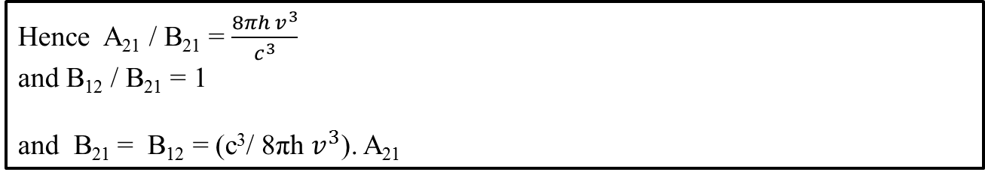
From Boltzmann’s equation
Hence
From Plank’s energy distribution formula
Hence A₂₁ / B₂₁ = $\frac{8πh v^{3}}{c^{3}}$
and B₁₂ / B₂₁ = 1
and B₂₁ = B₁₂ = (c³/ 8πh $v^{3}$). A₂₁
Einstein coefficient Relationship

Slide 13
Light Amplification
Conditions under which the number of stimulated transitions can be made larger than the other two transition:
Condition for stimulated emission to dominate spontaneous emission
- Population Inversion
Requirement of states of larger lifetimes
- Metastable States
Condition for stimulated emission to dominate absorption transition
- Confining Radiation within the medium

Slide 14
Power Supply
Lasing Medium
- gas, solid or liquid material that generates laser light
Pumping Device
- creates population inversion essential for laser operation
Optical Resonant Cavity
- chamber where population inversion occurs that contains reflecting surfaces

Slide 15
Lasing Action
Step 1: Pumping
- The atoms in the medium are in ground state initially. By supplying energy from an external source, the atoms are excited from the ground level to an excited state.
Step 2: Population Inversion
- The lifetime of atoms at excited state is extremely small, of the order of 10⁻⁸ sec. Therefore, the atoms drop spontaneously from the exited state to the metastable state is comparatively longer (10⁻³ sec), the atoms go on accumulating at the metastable state. As soon as a the number of atoms at the metastable state exceed that of the ground state, the medium goes into the state of population inversion.
Step 3: Spontaneous Emissions
- Some of the excited atoms at the metastable state may emit photos spontaneously. Each spontaneous photon can trigger many stimulated transitions along the direction of its propagation.
Step 4: Amplification
- A majority of photons traveling along the axis cause stimulated emission and are reflected back on reaching the end mirror. They travel towards the opposite mirror and on their way stimulate more and more atoms .
Step 5: Oscillations
- For proper build up of oscillations, it is essential that the amplification between two consecutive reflections of light from rear end mirror can balance the losses. Strong laser beam emerge out.

Slide 16
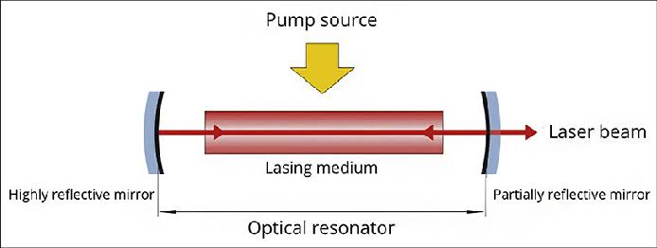
Components of laser
Active Medium
The Pump
Optical Resonator
Schematic diagram of Laser

Slide 17
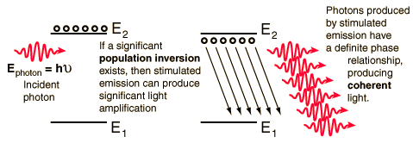
When a sizable population of electrons resides in upper levels, this condition is called a "population inversion", and it sets the stage for stimulated emission of multiple photons. This is the precondition for the light amplification which occurs in a LASER and since the emitted photons have a definite time and phase relation to each other, the light has a high degree of coherence.

Slide 18
Inverted Population
In order to obtain the coherent light from stimulated
emission, two conditions must be satisfied:
The atoms must be excited to the higher state. That is, an inverted population is needed, one in which more atoms are in the upper state than in the lower one, so that emission of photons will dominate over absorption.
Unexcited system
Excited system

Slide 19
Population inversion
Mirror
Mirror
Population inversion can be created by introducing a so call metastable centre where electrons can piled up to achieve a situation where more N₂ than N₁
The process of attaining a population inversion is called pumping and the objective is to obtain a non-thermal equilibrium.
It is not possible to achieve population inversion with a 2-state system.
If the radiation flux is made very large the probability of stimulated emission and absorption can be made far exceed the rate of spontaneous emission.
But in 2-state system, the best we can get is N₁ = N₂.
To create population inversion, a 3-state system is required.
The system is pumped with radiation of energy E₃₁ then atoms in state 3 relax to state 2 non radiatively.
The electrons from E₂ will now jump to E₁ to give out radiation.

Slide 20
Metastable State
2. The higher state must be a metastable state – a state in which the electrons remain longer than usual so that the transition to the lower state occurs by stimulated emission rather than spontaneously.
Metastable state
Incident photon
Photon of energy
Emitted photon
Metastable system
Stimulated emission

Slide 21
Spontaneous émission (production of chance photon)
Mirror
Mirror

Slide 22
Optical Resonator
Stimulated emission
Mirror
Mirror

Slide 23
Feed-back by the cavity
Mirror
Mirror

Slide 24
Stimulated emission
Mirror
Mirror

Slide 25
Feed-back by the cavity
Mirror
Mirror

Slide 26
After several round trips…
Mirror
Mirror
Laser beam
Photons with:
- same energy : Monochromatic
- same direction of propagation : Spatial cohérence
- all in synchrony: Temporal cohérence

Slide 27
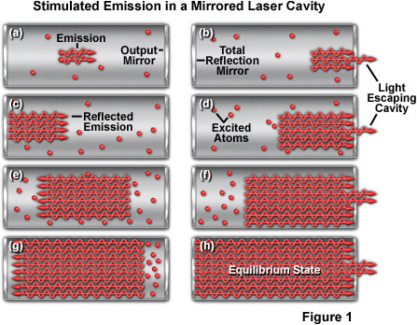
Optical Resonator

Slide 28
Pumping
In order to invert population of atomic levels the atoms must be excited by depositing energy in the medium using such method as to to increase the number of atoms at the upper level N₂ and decrease the number of atoms at the lower level N₁. This process is called pumping since the atoms are redistributed as if pumped from the lower level to the upper level.
The methods of pumping are
i) optical pumping, where the atoms are excited by illumination of light
ii) excitation by electric discharge in the case of gases
iii) Injection of carriers by a forward current through a p-n junction in the case of semi-conductors
iv) excitation by irradiation with electron beams
v) excitation by chemical reaction

Slide 29
Types of Lasers
Classified according to the nature of material between two reflecting surfaces
Solid State laser or Crystal lasers
synthetic ruby (aluminum oxide and chromium)
neodymium, yttrium, aluminum, garnet (Nd:YAG)
Gas lasers
helium neon (HeNe)
argon
carbon dioxide (CO₂)

Slide 30
Low- Vs. High-Power Lasers
High power lasers = "hot" lasers
Generate thermal responses
used in medicine for surgical cutting and coagulation, ophthalmological, dermatological, oncological and vascular specialties
Low power lasers = “cold” lasers
Produce a maximal output of less than 1 mW
Cause photo-chemical rather than thermal effects

Slide 31
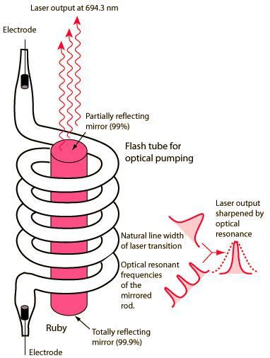
RUBY LASER
Rod length 2 – 20 cm; 0.1 – 2 cm diameter
Diagram of Ruby Laser

Slide 32
Construction
A ruby laser is a solid-state laser that uses a synthetic ruby crystal as its gain medium.
The ruby mineral (corundum) is aluminum oxide with a small amount(about 0.05%) of chromium which gives it its characteristic pink or red color by absorbing green and blue light. The ruby laser is used as a pulsed laser, producing red light at 694.3 nm.
The rod's ends had to be polished, such that one end is 100% reflecting and other end is partially reflecting.
A xenon lamp is rolled over ruby rod and is used for pumping ions to excited state. After receiving a pumping flash from the flash tube, the laser light emerges for as long as the excited atoms persist in the ruby rod, which is typically about a millisecond.

Slide 33
Three level laser
E₃
Fast transition
E₂
E₁
E1→E3 pumping
spontaneous emission E3 →E2.
state E2 is a metastable state
population inversion between states E2 and E1.
stimulated emission between E2 to E1.

Slide 34
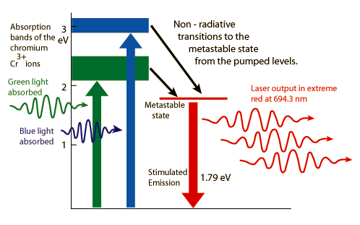
Working of ruby laser
Ruby laser is based on three energy levels. The upper energy level E3 I short-lived, E1 is ground state, E2 is metastable state with lifetime of 0.003 sec.

Slide 35
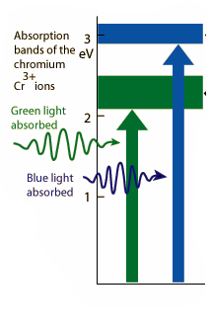
When a flash of light falls on ruby rod, radiations of wavelength 5500 are absorbed by Cr3+ which are pumped to E3.

Slide 36

The ions after giving a part of their energy to crystal lattice decay to E2 state undergoing radiation less transition.
Metastable state
In metastable state , the concentration of ions increases while that of E₁ decreases. Hence, population inversion is achieved.

Slide 37


A spontaneous emission photon by Cr³⁺ ion at E₂ level initiates the stimulated emission by other Cr³⁺ ions in metastable state
Metastable state
1.79 eV

Slide 38
Application of Ruby Laser
Ruby lasers have declined in use with the discovery of better lasing media. They are still used in a number of applications where short pulses of red light are required. Holographers around the world produce holographic portraits with ruby lasers, in sizes up to a meter squared.
Many non-destructive testing labs use ruby lasers to create holograms of large objects such as aircraft tires to look for weaknesses in the lining.
Ruby lasers were used extensively in tattoo and hair removal

Slide 39
Drawbacks of Ruby laser
The laser requires high pumping power because the laser transition terminates at the ground state and more than half of ground state atoms must be pumped to higher state to achieve population inversion.
The efficiency of ruby laser is very low because only green component of the pumping light is used while the rest of components are left unused.
The laser output is not continuous but occurs in the form of pulses of microseconds duration.
The defects due to crystalline imperfection are also present in this laser.

Slide 40
Nd:YAG Laser

Slide 41
Nd: YAG Laser (Doped insulator laser) :
Lasing medium :
The host medium for this laser is Yttrium Aluminium Garnet (YAG = Y₃ Al₅ O₁₂) with 1.5% trivalent neodymium ions (Nd³⁺) present as impurities.
The (Nd³⁺) ions occupy the lattice sites of yttrium ions as substitutional impurities and provide the energy levels for both pumping and lasing transitions.

Slide 42
Contd.
When an (Nd³⁺) ion is placed in a host crystal lattice it is subjected to the electrostatic field of the surrounding ions, the so called crystal field.
The crystal field modifies the transition probabilities between the various energy levels of the Nd³⁺ ion so that some transitions, which are forbidden in the free ion, become allowed.

Slide 43
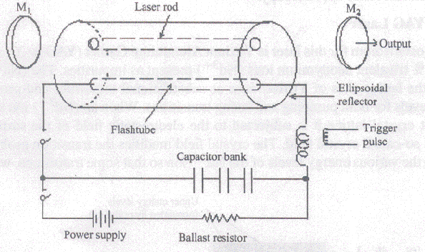

Slide 44
The length of the Nd: YAG laser rod various from 5cm to 10cm depending on the power of the laser and its diameter is generally 6 to 9 mm.
The laser rod and a linear flash lamp are housed in a elliptical reflector cavity
Since the rod and the lamp are located at the foci of the ellipse, the light emitted by the lamp is effectively coupled to the rod.
The ends of the rod are polished and made optically flat and parallel.

Slide 45
Contd.
The optical cavity is formed either by silvering the two ends of the rod or by using two external reflecting mirrors.
One mirror is made hundred percent reflecting while the other mirror is left slightly transmitting to draw the output
The system is cooled by either air or water circulation.

Slide 47
This laser system has two absorption bands (0.73 μm and 0.8 μm)
Optical pumping mechanism is employed.
Laser transition takes place between two laser levels at 1.06 mm.

Slide 48
OUTPUT CHARACTERISTICS :
The laser output is in the form of pulses with higher repetition rate
Xenon flash lamps are used for pulsed output.
Nd: YAG laser can be operated in CW mode also using tungsten-halide incandescent lamp for optical pumping.
Continuous output powers of over 1KW are obtained.

Slide 49
Note: Nd: Glass laser :
Glass acts as an excellent host material for neodymium.
As in YAG, within the glass also local electric fields modify the Nd³⁺ ion energy levels.
Since the line width is much broader in glass than in YAG for Nd³⁺ ions, the threshold pump power required for laser action is higher.
Nd: Glass lasers are operated in the pulsed mode at wavelength 1.06 μm

Slide 50
Nd:YAG/ Nd: Glass laser applications :
These lasers are used in many scientific applications which involve generation of other wavelengths of light.
The important industrial uses of YAG and glass lasers have been in materials processing such as welding, cutting, drilling.
Since 1.06 μm wavelength radiation passes through optical fibre without absorption, fibre optic endoscopes with YAG lasers are used to treat gastrointestinal bleeding.

Slide 51
Contd.
YAG beams penetrate the lens of the eye to perform intracular procedures.
YAG lasers are used in military as range finders and target designators.

Slide 52
Calculate the wavelength of emission from GaAs semiconductor laser whose band gap energy is 1.44 ev (plank’s constant is 6.625 x 10⁻³⁴ Js and charge of an electron is 1.6 x 10⁻¹⁹ C. Given data : Band gap energy Eg = 1.44 ev (or) 1.44 x 1.6 x 10⁻¹⁹ Joules. Solution : We know Band gap energy (Eg) = hν (or) hc/λ we can write λ = hc/E_{g} λ _{= 6.625 x 10}⁻³⁴ _{x 3 x 10}⁸_{) / (1.44 x 1.6 x 10}⁻¹⁹₎ _{= 8.6263 x 10}⁻⁷ _{m} _{= 8626.3 x 10}⁻¹⁰ _{m} ∴ wave length of GaAs laser = 8626.3 Aº

Slide 53
CO₂ laser
Construction
The carbon dioxide laser is a four level molecular laser and operates at 10.6 μm in far IR region.
The tube is filled with a mixture of carbon dioxide, nitrogen and helium in 1:4:5 proportions which constitute a lasing medium.
The active center are CO₂ molecules lasing on the trnsitions between the vibrational levels of the electronic ground state.
Working
When current passes through the mixture of gases, the N₂ molecules get excited to the metastable state.
The excited N₂ molecules cannot spontaneously lose their energy and consequently, the number of N₂ molecules at the metastable level builds up.
The N₂ molecules undergo inelastic collisions with ground state CO₂ molecules and excite them to E₅ level. Some of the CO₂ molecules are also excited to the upper level E₅ through collisions with electron.

Slide 54
CO₂ Lasers Theory
Vibration levels
Energy storage
Bending mode
Symmetric Stretching mode
Asymmetric Stretching mode: (001)≈ 0.3eV
Vibrational energy:
Rotational energy:

Slide 55
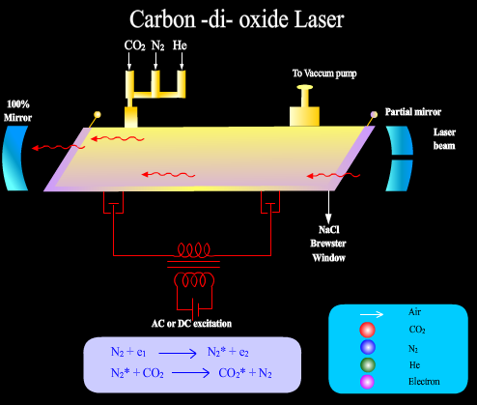

Slide 56
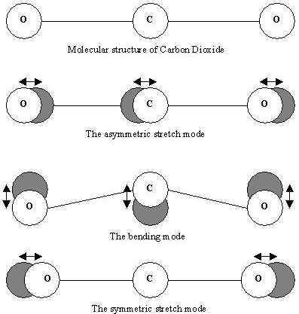

Slide 57
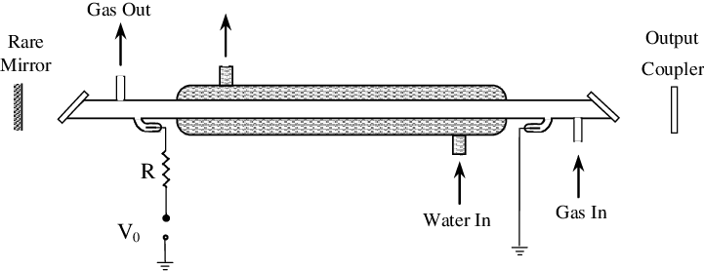
Schematic of a carbon dioxide laser

Slide 58
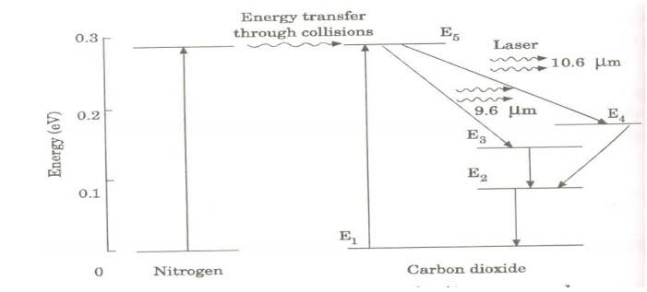
Energy levels of nitrogen and carbon dioxide molecules and transition between the levels

Slide 59
Working
When an electric discharge occurs in the gas, the electrons collide with nitrogen molecules and they are raised to excited states. This process is represented by the equation
N₂ + e* = N₂*
N₂ = Nitrogen molecule in ground state e* = electron with kinetic energy, N₂* = nitrogen molecule in excited state.
Now N₂ molecules in the excited state collide with CO₂ atoms in ground state and excite to higher electronic, vibrational and rotational levels.
This process is represented by the equation N2* + CO₂ = CO₂* + N₂
N₂* = Nitrogen molecule in excited state. CO2 = Carbon dioxide atoms in ground state
CO₂* = Carbon dioxide atoms in excited state. N₂ = Nitrogen molecule in ground state.
Since the excited level of nitrogen is very close to the E₅ level of CO₂ atom, population in E₅ level increases.
As soon as population inversion is reached, any of the spontaneously emitted photon will trigger laser action in the tube.
There are two types of laser transition possible.
Transition E5 to E4 :
This will produce a laser beam of wavelength 10.6μm
Transition E5 to E3
This transition will produce a laser beam of wavelength 9.6μm. Normally 10.6μm transition is more intense than 9.6μm transition. The power output from this laser is 10kW.
The carbon dioxide laser usually produces a beam that is invisible to the naked eye, but can go through the atmosphere so that it can be used as a cutting or welding device in industry.

Slide 60
The exited state of nitrogen molecule is metastable and is identical in energy to (001) vibrational level of CO₂ molecule. When current passes through the mixture of gases, the N₂ molecules get exited to the metastable state, which cannot spontaneously loose their energy. Hence the number of N⁺ molecules in the metastable state build up. These N₂ molecule suffer inelastic collision with CO₂ molecule in the ground state and excite them to E₅ level. Also some CO₂ molecules suffer collision with electrons exited to E₅ level.
In the energy level diagram E₅ is the upper energy level and E₃ and E₄ are the lower energy levels. The necessary population inversion is achieved between E₅ level and E₃ and E₄ levels.
The laser transition E₅ to E₄ produces IR radiations at10.6 μm and E₅ to E₃ produces IR radiations at 9.6 μm.
E₃ and E₄ are metastable state and from which transition occurs to E₂ through inelastic collisions with unexcited CO₂ molecules, which increases population of E₂ The presence of He with CO₂ helps to reduce population density at E₂. It deexcite CO₂ molecules to E₁ through inelastic collision

Slide 61
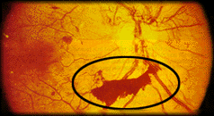
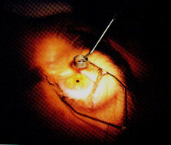
Uses of Laser (1)
In medicine
to break up gallstones and kidney stones,
to weld broken tissue (e.g. detached retina)
to destroy cancerous and precancerous cells; at the same time, the heat seal off capillaries,
to remove plaque clogging human arteries.

Slide 62
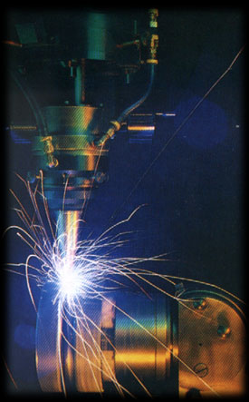
Uses of Laser (2)
In industry
drilling
for welding and machining,
Hardening – Heat treatment to harden metals in tooling and automotive industry.
Electronic industry – It is used in manufacturing of electronic component and integrated circuits.

Slide 63
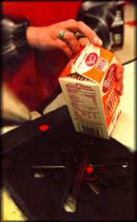
Uses of laser (3)
In everyday life
to be used as bar-code readers,
to be used in compact disc players,
to produce short pulses of light used in digital communications,
to produce holograms.

Slide 64
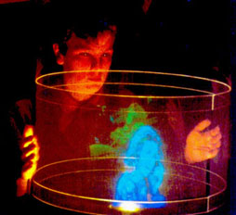
Holography
Holography is the production of holograms by the use of laser.
A hologram is a 3D image recorded in a special photographic plate.
The image appears to float in space and to move when the viewer moves.
In laser holography, the hologram is recorded using a source of laser light, which is very pure in its color and orderly in its composition.
Various setups may be used, and several types of holograms can be made, but all involve the interaction of light coming from different directions and producing a microscopic interference pattern which a plate, film, or other medium photographically records.

